Slide 1
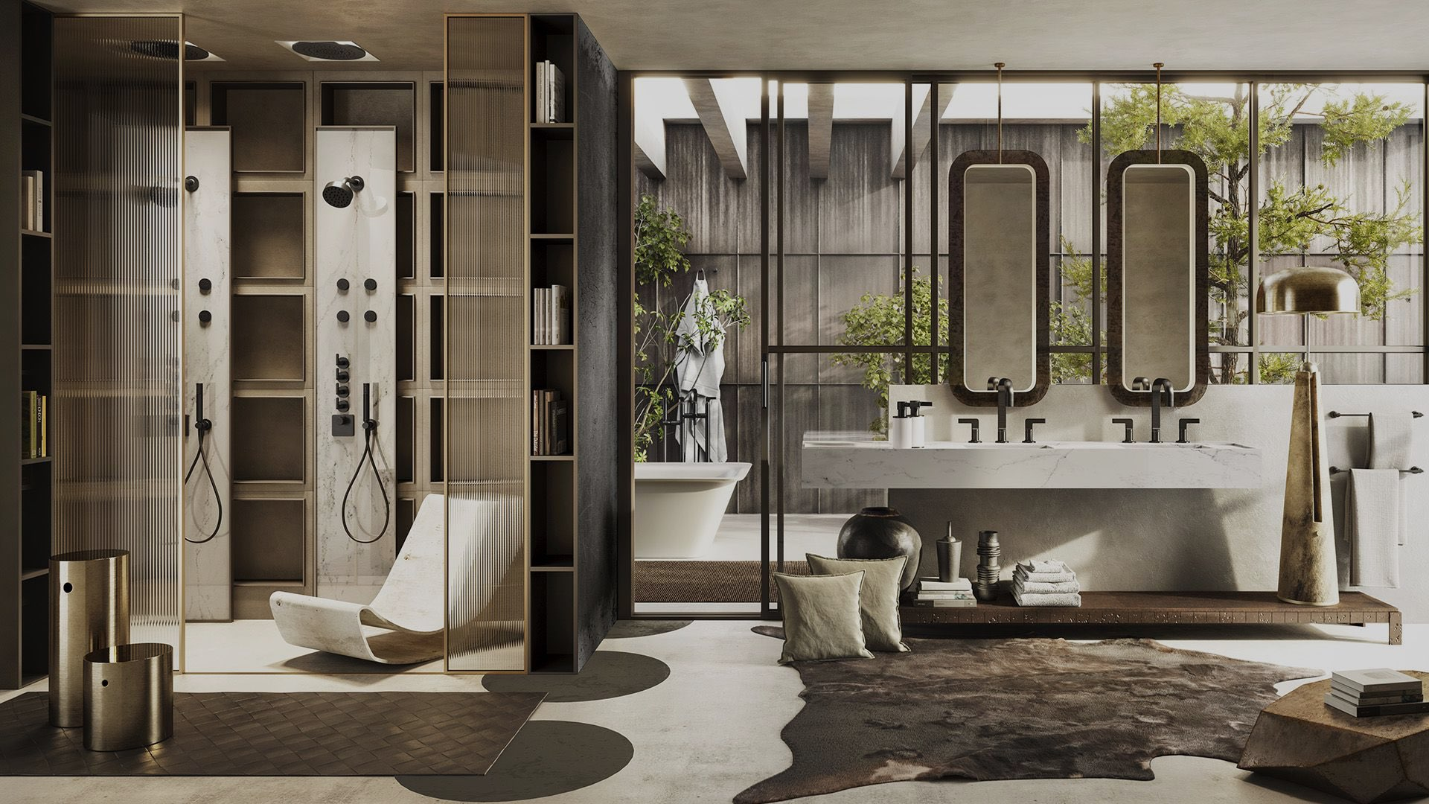

PROPOSED SELECTIONS
SANITARYWARE |
April 15,2025
SP-YR25-0015M-Rev00
MAF - MOE

Slide 2
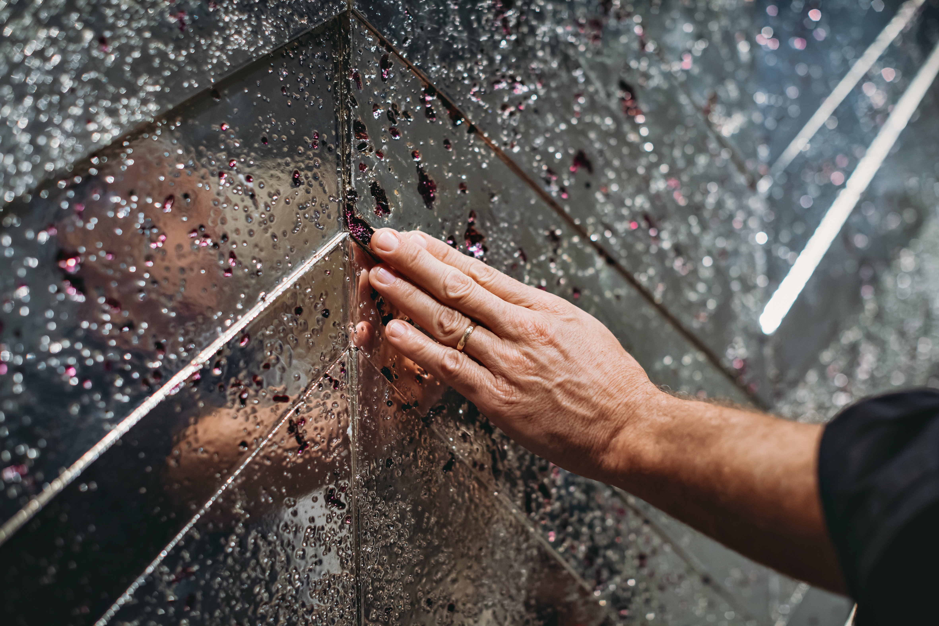

The Inclusions
The following document includes the details and specifications of products chosen or suggested in the proposed selections. Our products are selectively curated from globally renowned brands, renowened for quality and heritage.
The compiled moodboard and other compilations are for illustration purposes only, please do consult with us should you need alterations in the selections.

Slide 3
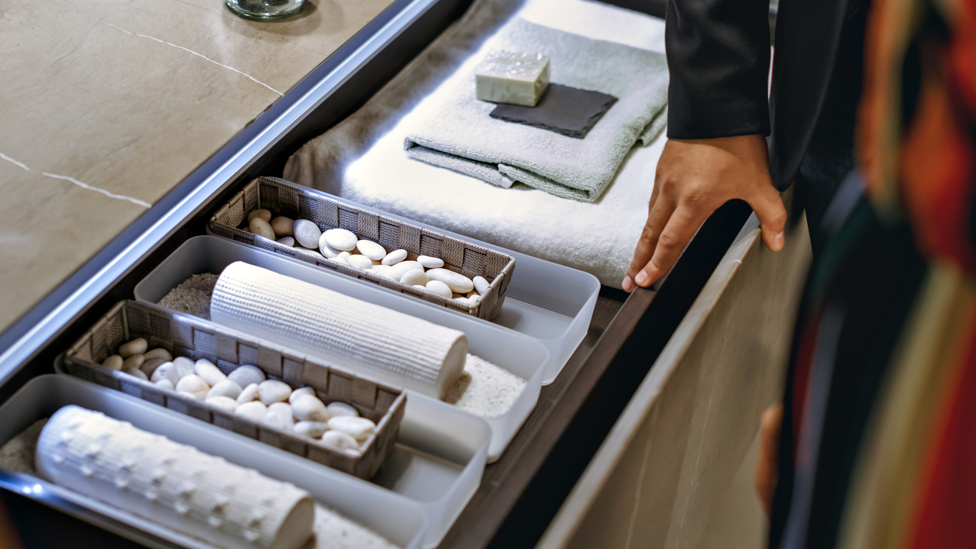

Our products have additional inclusions and features as well, please consult with us for on the possibilities of customizing the finish, interiors and more

Slide 4
Ambani Villas
Auto-generated Product Specification

Slide 5
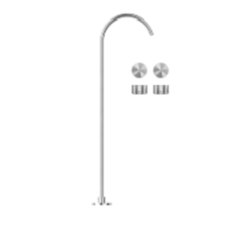
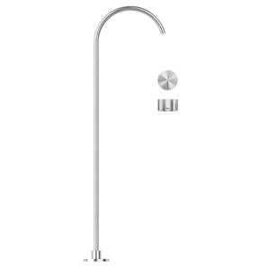
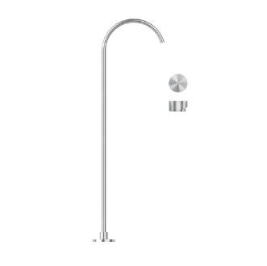
Anant Ambani toyroom
#A53 - Falper Acquifero Washbasin Set with Freestanding Spout Art. GRH00000000SP and External Parts Art. GVC00000000SP Stainless Steel h1127mm
Colour: Stainless Steel
Category: Basin Mixer
Finish: Brushed
Collection: Freestanding
#A52 - Falper Aquifero Washbasin Set with Freestanding Spout Art. GRH0000000SP and Hydroprogressive Flow Control Art. GVB0000000SP Brushed Stainless Steel H1127mm
Colour: Stainless Steel
Category: Basin Mixer
Finish: Brushed
Collection: Freestanding
#A51 - Falper Acquifero Freestanding Basin Mixer (Arco Freestanding Basin Spout Art. GVA00000000PM and Acquifero Wall Mounted Mixer Flow Control Art. GVA00000000PM) Matt Black h1127mm
Colour: Black
Category: Basin Mixer
Finish: Matt
Collection: Freestanding

Slide 6
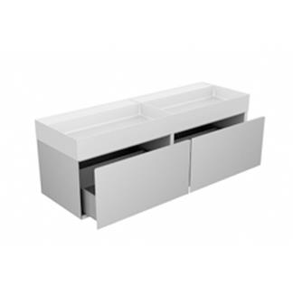
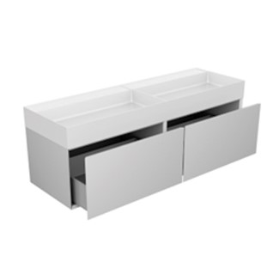
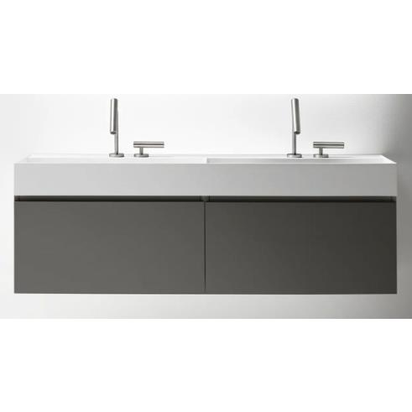
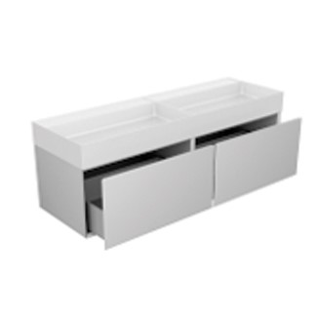
Anants Brothers Room
#1S-D7IOP-QF1EY-DA9 - Falper Quattro.Zero Unit with 2 Drawers Art. QF1X1001100EY and Washbasin Art. D7I14000000OP
Category: Vanity Unit
Collection: 2-Drawer
#1S-DA9-DS4 - Falper Quattro.Zero with 2 Drawers Art. QF107000100B0 and Washbasin Art. D7I14000000OP, Grooved Handle Art. DA90000100000 and Viega Siphon Cut Art. DS40000000000
Colour: Beige
Category: Vanity Unit
Finish: Matt
Collection: 2 Drawers
#1S-OP-EY - Falper Quattro.Zero with 2 Drawers and Washbasin (with D7I14000000OP, QF107000100EY, DA90000100000, DS40000000000)
Colour: White-Grey
Category: Vanity Unit
Finish: Matt
Collection: 2 Drawers
#1S-QF1B0-D7IOP - Falper Quattro.Zero Unit with 2 Drawers Art. QF107000100B0 and Washbasin Art. D7I14000000OP Matt White (B0)
Colour: White
Category: Vanity Unit
Finish: Matt
Collection: 2 Drawers

